Slide 1

Medical Report Summarization
Team 19
Ravi Shankar Sankara Narayanan,
Prithiv Rajkumar,
Mahadharsan Ravichandran,
Bhuvan Karthik Channagiri

Slide 2
Why we chose this topic
Medical reports are lengthy and complex which is difficult for nonmedical professionals.
General public will find it laborious to search and understand the cryptical medical terms in the report.
Our project is to create summaries from the medical report by extracting the important points.
We will add definition for the medical terms in the end to aid comprehension.
Problem Statement

Slide 3
Summarization
There are two types of summarization in NLP – Abstractive Summarization and Extractive Summarization
Abstractive Summarization
Creating a summary shorter than original text using different words without losing context.
Extractive Summarization
Creating a summary by selecting important sentences and phrases from the original text.

Slide 4
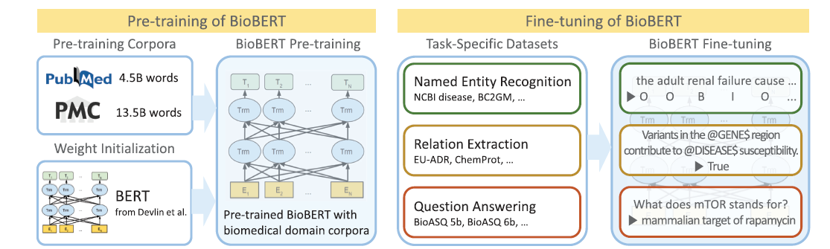
What is BioBERT
BERT is basically a trained Transformer Encoder stack.
BioBERT is a domain-specific variant of BERT, pre-trained on biomedical text to better understand and process medical and biological language.

Slide 5
Extractive Summary – How its done?
Extract relevant information from the original report.
1
Encode these sentence to BERT Tokenizer and BERT model to get system embeddings.
2
Calculate the cosine similarity between sentence embeddings to get similarity matrix.
3
Use Page Rank Algorithm to each sentence based on its similarity to other sentence.
4
Refine the summarization by defining the top ranked sentences to be printed out.

Slide 6
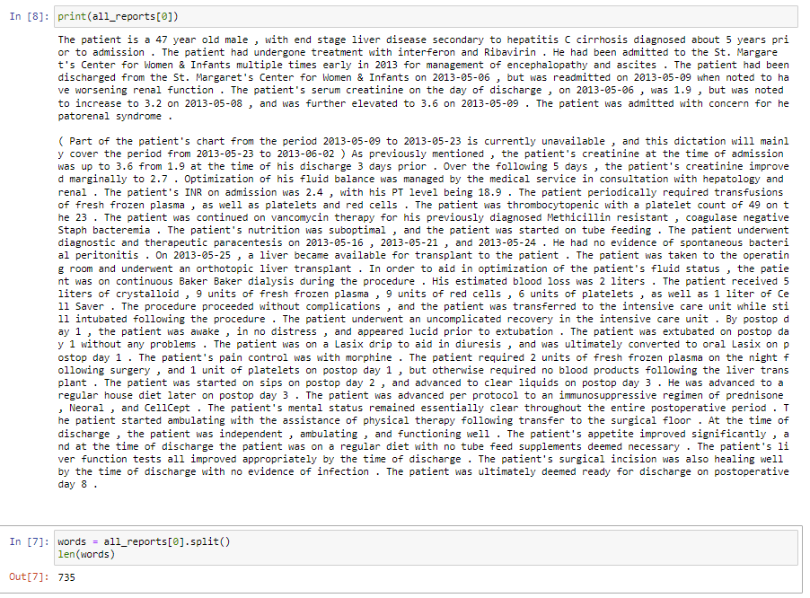
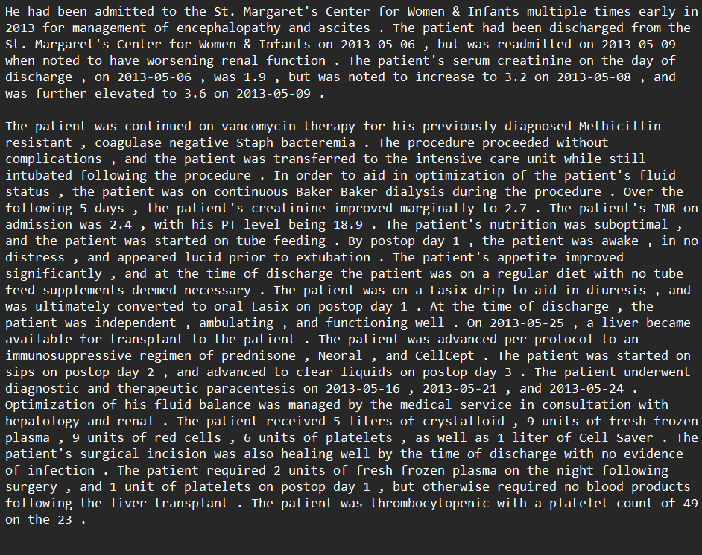
Extractive Summary Result

Slide 7
Named Entity Recognition
Load the summarized document from BioBERT and Implement scispaCy to recognize biomedical text in summary.
The program creates key value pairs for the entities it identifies in the documents
Which extract the meaning from these entities by two methods
For multiword phrases, we extract the first sentence of the Wikipedia page for its meaning.
If its not a multi word phrase it extracts it from WordNet.
The entity with its definition is added to the end of summary line

Slide 8
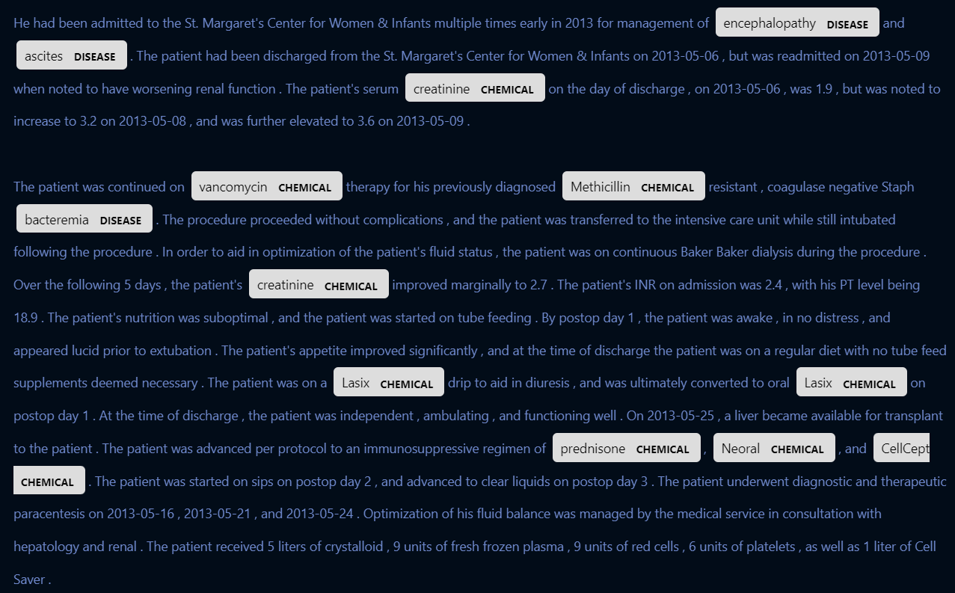
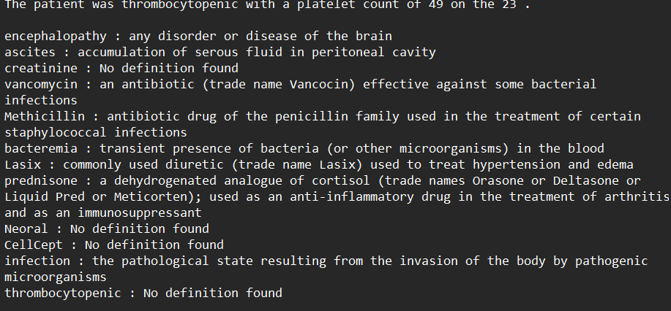
NER Result
SciSpacy was able to detect the biomedical entities from the report and extract its definition from Wikipedia and WordNet

Slide 9
Future Scope for this Project
Implement a chatbot with Llama-2 and FAISS
Finetune BioBERT with BioASQ for question answering
Implement a front end for this with Streamlit

Slide 10

Questions

